Slide 1
BML735 BIOMEDICAL SIGNAL & IMAGE PROCESSING
PROJECT REPORT
BY-
AJINKYA WASNIK
2018EET2569

Slide 2
METHODS
There are primarily a few methods using which the task at the hand could be done.
I have used methods in following order on the images to be segmented for tumour:
Firstly, did some thresholding by using two conditions:
Apply operations only if non-zero no. of pixels in that particular ground truth is greater than 1000
Also, checking if max value of ground truth is less than 4.
Secondly, on the masks we got I normalized them and then chose proper indexes of tumor to get different types of tumour tissues
Thirdly, I applied k-means with different K value on t1ce and flair image
Hence I got masks for different tumour tissues.

Slide 3
METHODS(contd.)
Now I have 2 types of tumour tissues but there’s also a third type of tumour tissue which is indexed 1 and is inside index 4 tumour tissue.
So I filled the region inside 4index tissues by imfill() then subtracted the new mask from 4th index mask
So now we have all three tumour tissues(1,2 & 4).
Next I applied morphological operations to improve the masks we got in previous steps.
And Finally calculated Dice Coefficient. ***All above process was done slice by slice.
Also I applied Region Growing for comparing the Dice’s coefficient value.

Slide 4
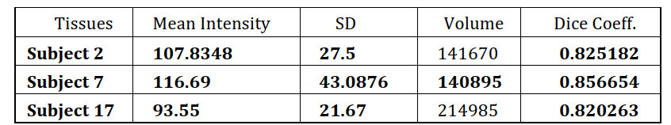
RESULTS
I took a tumour mask for T1ce and another one mask for flair and also a third tumor mask from the filling of 4th index section and subtracting it
(Explained in report with code)
Final Results are combination of all the masks.
Subject-wise the data varies in different metrics as shown in below table Average value of Dice coefficient achieved considered 3 patients= 0.834033
(around 84% accuracy achieved)

Slide 5
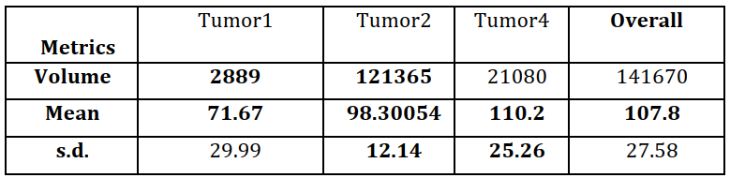
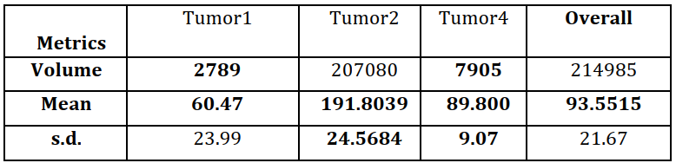

Slide 6
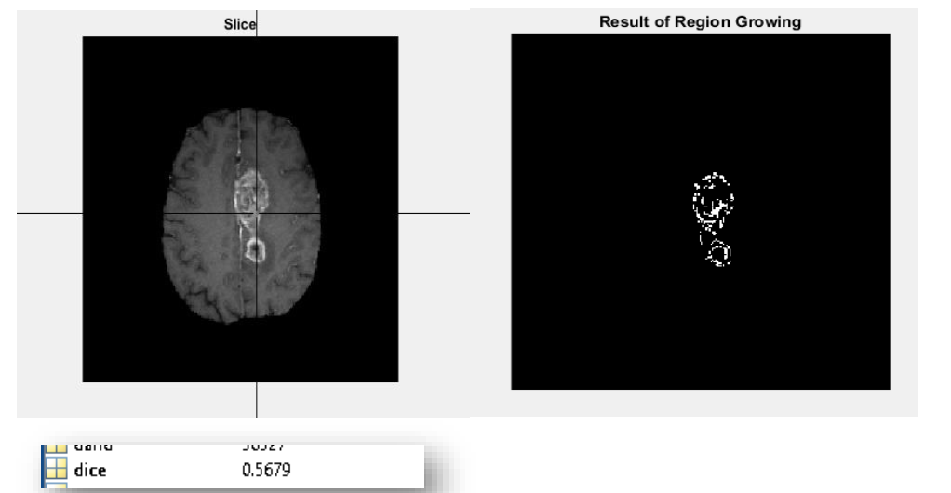
Patient #2 going under region Growing based Segmentation
Region Growing results for comparison.

Slide 7
DISCUSSION
Region Growing is too much dependent on seed’s value for giving a good segmentation.
Region Growing algorithm, I used was a 3D region growing algorithm.
Its Dice Coefficient value ranges from 0.50-0.70 for different patients.
Tumour 4 being the brightest part usually is easy to segment properly in an algorithmic way, whereas same can’t be said about other tumour tissues.
For getting label1 tumorous tissue we did imfill() operation on 4th label tumorous tissue and so we subtracted resulting one from 4th one, to get 1 label tumour tissue
I did even try Otsu thresholding but it didn’t gave very good dice-coefficient value. It was on an average giving around 75% accuracy if we take best coefficients(3 patients) we achieve from all patients.
We can also try EM based method for achieving the better dice’s coefficient value.

Slide 8
THANK YOU

